Slide 1
Getting to Know Test Driven Development & Design
Oren Eini
Senior Developer
We! Consulting Group
orene@we-can.co.il
http://www.ayende.com/Blog/

Slide 2
Who am I?
Oren Eini (a.k.a: Ayende Rahien)
Blogger (http://www.ayende.com/Blog/)
Senior Developer at We! Consulting Group

Slide 3
Test Driven Design
As a matter of fact, it is not about the tests
The design process:
Forcing good design
Verifiability
Coherent pieces
Single responsibility principal

Slide 4
How do we do it today?

Slide 5
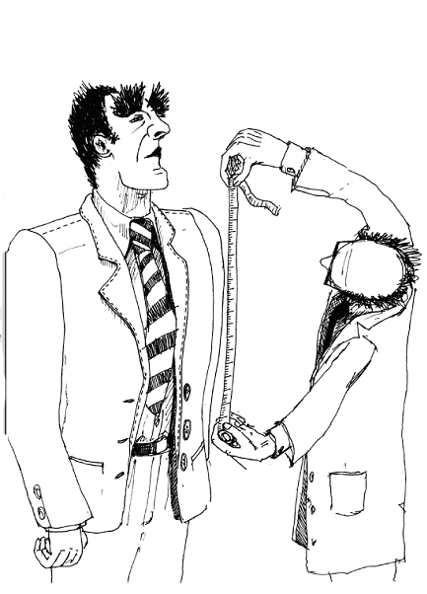
Requirements

Slide 6

Development

Slide 7
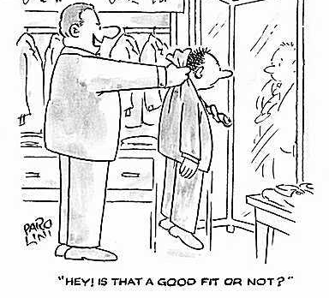
Testing
F5

Slide 8
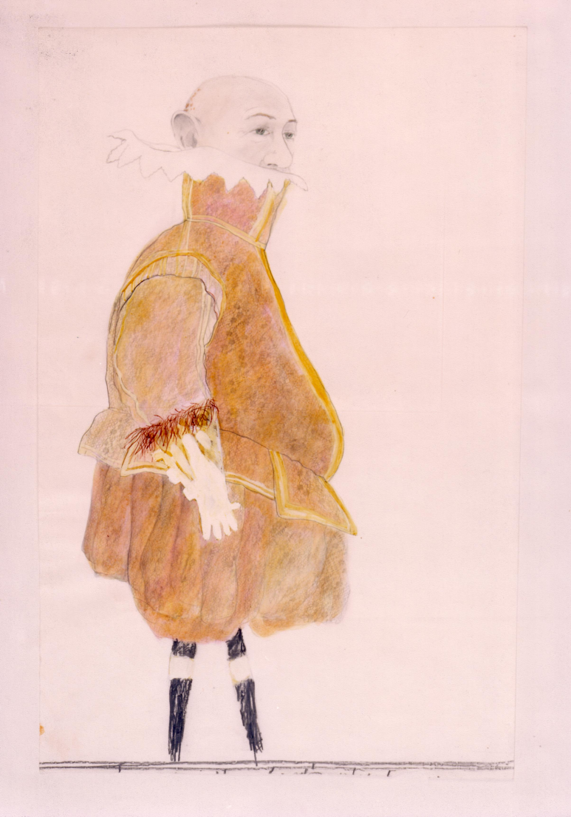
End Result
But we can’t change it now!

Slide 9

And this is how deployment felt

Slide 10
Another way…

Slide 11
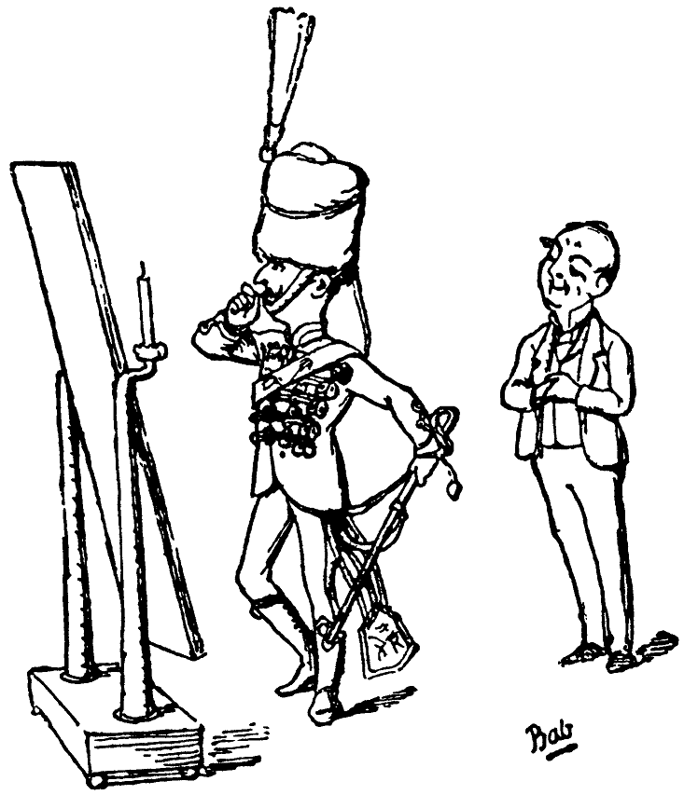

Continuous Feedback

Slide 12
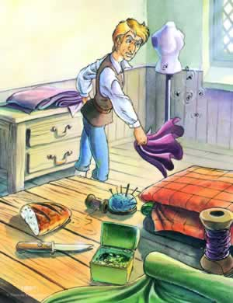

Enabling Change

Slide 13
Getting serious
TDD as specification
After development – serves as verification
Unit test should not:
Talk to the database
Communicate across the network
Touches the file system
Unit test:
Test one thing
Run fast

Slide 14
Let us start with some code…
We need to build a calculate employee salary
Requirements:
Hourly pay
If temp – no overtime payment
If manager – overtime +60% per hour
If employee – overtime +50% per hour

Slide 15
The process
Write a test
Watch it fail
Make it pass
Refactor

Slide 16
The first test…
Small steps
<Test()> _
Public Sub Calculate_NoHours_WillReturnZero()
Dim calculator As New SalaryCalculator
Dim result As Decimal
result = calculator.Calculate()
Assert.AreEqual(0, result)
End Sub

Slide 17

When we have tests…
We know the health of the software
It is broken?
In what manner?
Can we ship?
What happen if I change this method?
Why is it breaking on his machine?
We can safely change our code!

Slide 18

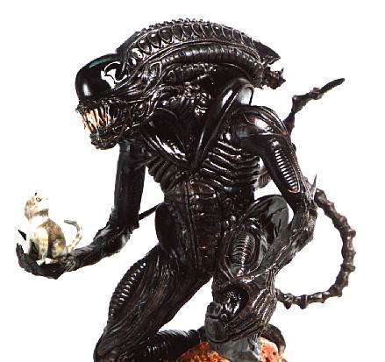

Legacy Code
What the does this code do?
Surely written by aliens
Or barbarians

Slide 19

Dealing with legacy code
Characterization Tests
Hippocratic Oath
Make it better
Cut new Seams
Strangler Application
'I have no idea how this works but it seems to. Whatever you
'do, don't touch this function, and don't break this code!

Slide 20
Questions?

